Slide 1
Hashing

Slide 2
The Dictionary Problem
Given a series of operations: OP₁, OP₂, . . . . These operations are to be performed on an initially empty set S. Each operation OP_{i} can be one of the following:
Insert(x) An item with key value x is inserted into the set S.
Lookup(x) Check if an item with key value x is present in the set S.
Delete(x) The item with key value x, if present, is deleted from the set S.

Slide 3
The Dictionary Problem
Each of the key value x comes from a universe U, i.e. x ∈ U. In this document, we assume U = {1, 2, . . . N}.
Observe that the set S is a dynamic set. Each of the Insert and Delete operations may modify the set.
Hence the size of the set S changes with each operation.
We bound the maximum size of the set to n (n << N).

Slide 4
Hash tables and hash functions
What are the data structures that can be used to store the set S?
One option is to use a balanced binary search tree. But each of the operations would take O(log n) time. Moreover, a balanced binary search tree is more difficult to implement than, say, an array, or a singly linked list.
Could we store the set S in an array? Is there a data structure that would perform the above operations in constant time?
Yes, there is such a data structure, hash table, which provides an easy way of storing such information.

Slide 5
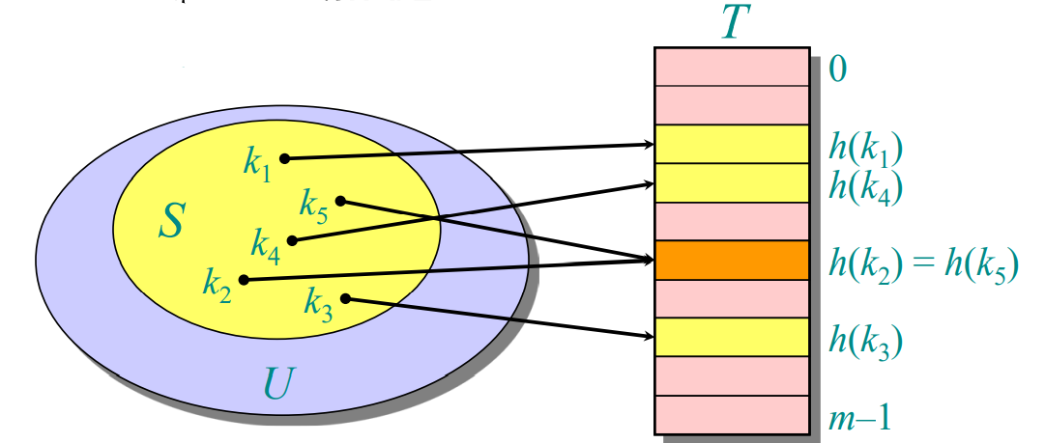
Hash tables and hash functions
Let us denote the hash table by T . A hash function maps the elements of the universe to the hash table, h : U −→ T .

Slide 6
Hash tables and hash functions
Let the size of the hash table be m. We would like the size of the hash table, m to be linear in the size of the set S.
The hash table cannot be as large as the universe of keys, N, in which case, there would be no collisions.
When the hash table is smaller than the universe, collisions will occur.

Slide 7
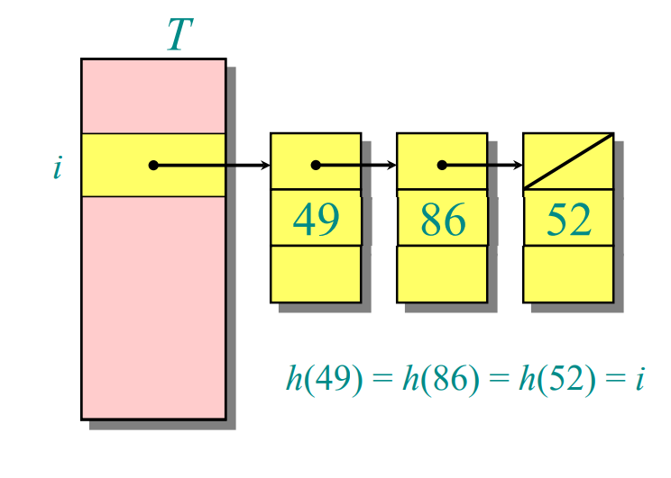
Resolving Collision
Link records in the same slot into a list.
Worst case:
Every key hashes to the same slot.
Access time = Θ(n) if |S| = n

Slide 8
Average-case analysis of chaining
We assume of simple uniform hashing:
Each key k ∈ S is equally likely to be hashed to any slot of table T, independent of where other keys are hashed.
Let n be the number of keys in the table, and let m be the number of slots.
Define the load factor of T to be α = n/m = average number of keys per slot.

Slide 9
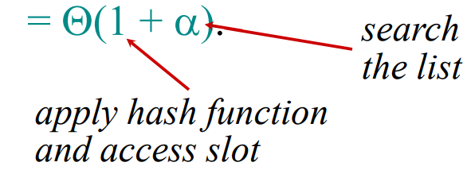
Search Cost
The expected time for an unsuccessful search for a record with a given key is
Expected search time = Θ(1) if α = O(1), or equivalently, if n = O(m).
A successful search has same asymptotic bound, but a rigorous argument is a little more complicated.

Slide 10
Choosing Hash function
The assumption of simple uniform hashing is hard to guarantee, but several common techniques tend to work well in practice as long as their deficiencies can be avoided.
Desired:
A good hash function should distribute the keys uniformly into the slots of the table.
Regularity in the key distribution should not affect this uniformity

Slide 11

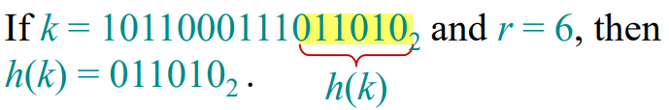
Division Method
Assume all keys are integers, and define h(k) = k mod m.
Deficiency: Don’t pick an m that has a small divisor d. A preponderance of keys that are congruent modulo d can adversely affect uniformity.
Extreme deficiency: If m = 2^{r} then the hash doesn’t even depend on all the bits of k:

Slide 12
Division Method
Pick m to be a prime not too close to a power of 2 or 10 and not otherwise used prominently in the computing environment.
Annoyance:
Sometimes, making the table size a prime is inconvenient.
But this method is popular, although the next method we’ll see is usually superior.

Slide 13
Multiplication method
Assume that all keys are integers, m = 2^{r}, and our computer has w-bit words.
Define h(k) = (A·k mod 2^{w}) rsh (w – r),
where rsh is the “bitwise right-shift” operator and A is an odd integer in the range 2^{w–1} < A < 2^{w}.
Don’t pick A too close to 2^{w–1} or 2^{w}.
Multiplication modulo 2^{w} is fast compared to division.
The rsh operator is fast.

Slide 14

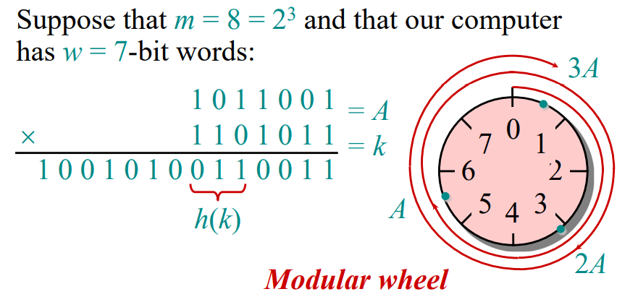
Multiplication method

Slide 15
Resolving collisions by open addressing
No storage is used outside of the hash table itself.
Insertion systematically probes the table until an empty slot is found.
The hash function depends on both the key and probe number:
h : U × {0, 1, …, m–1} → {0, 1, …, m–1}.
The probe sequence 〈h(k,0), h(k,1), …, h(k,m–1)〉 should be a permutation of {0, 1, …, m–1}.
The table may fill up, and deletion is difficult (but not impossible).

Slide 16
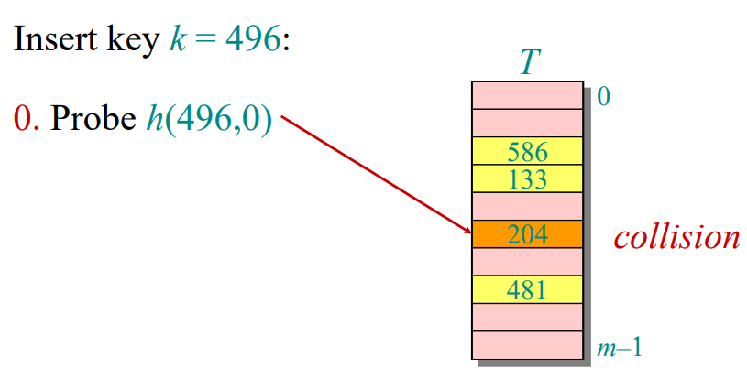
Example of open addressing

Slide 17
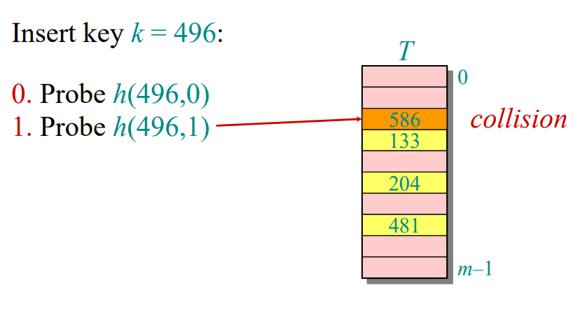
Example of open addressing

Slide 18
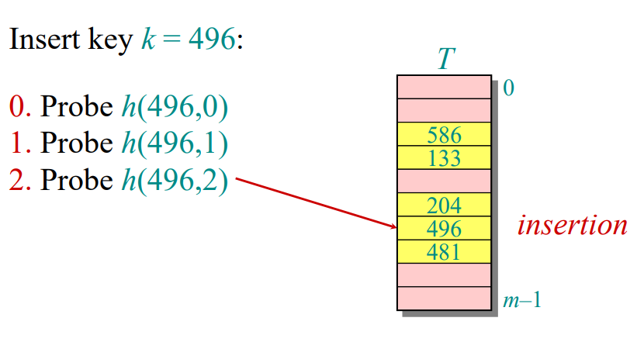
Example of open addressing

Slide 19
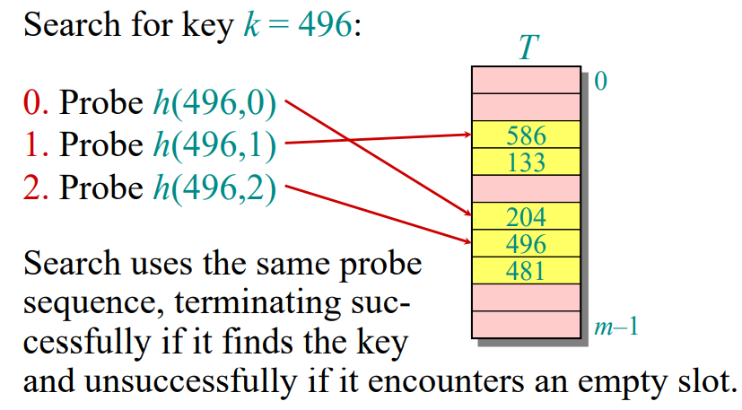
Example of open addressing

Slide 20
Probing strategies
Linear probing:
Given an ordinary hash function h′(k), linear probing uses the hash function
h(k,i) = (h′(k) + i) mod m.
This method, though simple, suffers from primary clustering, where long runs of occupied slots build up, increasing the average search time.
Moreover, the long runs of occupied slots tend to get longer.
Double hashing:
Given two ordinary hash functions h₁(k) and h₂(k), double hashing uses the hash function
h(k,i) = (h₁(k) + i⋅ h₂(k)) mod m.
This method generally produces excellent results, but h₂(k) must be relatively prime to m.
One way is to make m a power of 2 and design h₂(k) to produce only odd numbers

Slide 21
Analysis of open addressing
We assume of uniform hashing:
Each key is equally likely to have any one of the m! permutations as its probe sequence.
Theorem:
Given an open-addressed hash table with load factor α = n/m < 1, the expected number of probes in an unsuccessful search is at most 1/(1–α).

Slide 22

Proof of the theorem
Proof:
At least one probe is always necessary.
With probability n/m, the first probe hits an occupied slot, and a second probe is necessary.
With probability (n–1)/(m–1), the second probe hits an occupied slot, and a third probe is necessary.
With probability (n–2)/(m–2), the third probe hits an occupied slot, etc.
Observe that

Slide 23
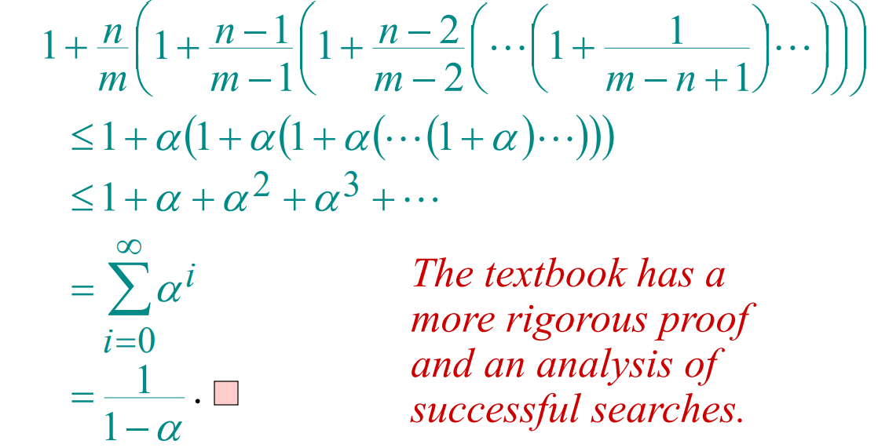
Proof of the theorem
Therefore, the expected number of probes is

Slide 24
Implications of the theorem
If α is constant, then accessing an open addressed hash table takes constant time.
If the table is half full, then the expected number of probes is
1/(1–0.5) = 2.
If the table is 90% full, then the expected number of probes is
1/(1–0.9) = 10.

Slide 25
Universal Hashing
How do we design a good hash function?
A set S of keys from a universe U = {0,1,...,m − 1} is supposed to be stored in a table of size n with indices T = {0,1,...,n − 1}.
Assume collisions are resolved using auxiliary data structure.
What we need is a hash function h : U → T with the following main requirements:
The hash function should minimize the number of collisions.
The space used should be proportional to the number of keys stored. (i.e., n ≈ |S|)

Slide 26
Universal Hashing
Claim 1: If m > n, then for any h there exists a key set S such that h has collision w.r.t. S (i.e., ∃x,y ∈ S,h(x) = h(y))
Claim 1.1: Any fixed hash function h : U → T, must map at least elements of U to some index in the set T.
Claim 2: For any fixed key set S such that |S| ≤ n, there exists a hash function such that h has no collisions w.r.t. S.
The issue is that the key set S is not known a-priori. That is, before using the data structure.
Question: How do we solve this problem then?

Slide 27
Universal Hashing
Question: How do we solve this problem then?
Randomly select a hash function from a family H of hash functions.

Slide 28
Universal Hashing
Theorem: Consider hashing using a 2-universal hash function family. Consider t insert operations, the expected cost of each operation is at most (1 + t/n).
Proof sketch: Consider any key x. The expected number of keys in location h(x) is at most t/n.

Slide 29
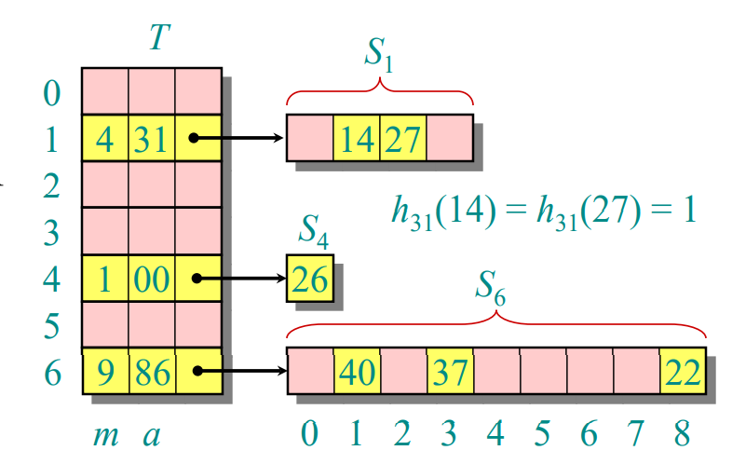
Perfect hashing
Given a set of n keys, construct a static hash table of size m = O(n) such that SEARCH takes Θ(1) time in the worst case.
IDEA: Two level scheme with universal hashing at both levels.
No collisions at level 2!

